Slide 1
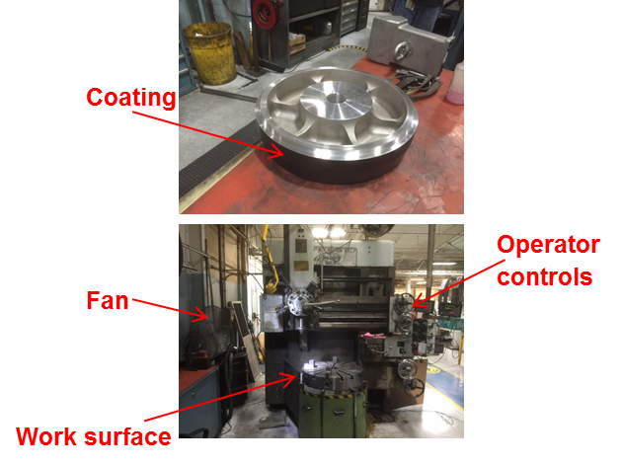
HS&E INCIDENT BULLETIN |  | 2nd half year 2016
Painted Post, New York | Type of incident (Respiratory - Inhalation)
Summary:
An employee was turning a coated part when the Teflon coating began to release dust and was subsequently inhaled by the employee. Following this, the employee complained of shortness of breath and difficulty breathing. An ambulance was called and the employee was taken to the hospital where he was treated and released.
Root Causes: | Actions Taken Thus Far: Next Steps
Rework from a supplier. Vendor failed to strip old Teflon coating from the part before recoating, which added to the outer diameter (OD) creating the need to turn down the OD of the part. Risk was not recognized. | Plant-wide Stand-Down conducted. Revised the risk assessment (HIRA). Supply Chain Management (SCM) worked with vendor on the coating process and the vendor to develop root cause/corrective actions. A comprehensive list of coatings used should be generated and published in each department. Non-Standard Work Review was updated. Machining of a part with a coating not machined in the cell and not specifically identified in the HIRA.

